Slide 1
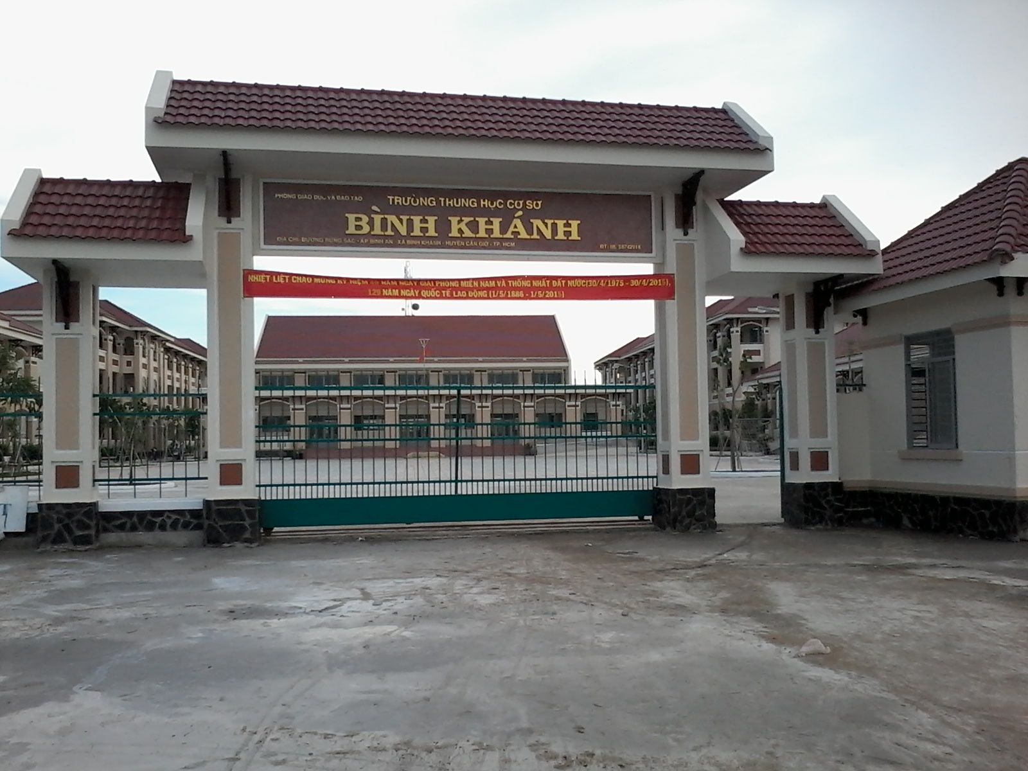



BINH KHANH SECONDARY SCHOOL
FRIENDS PLUS 6

Slide 2

UNIT 2: SPECIAL DAYS
LESSON 4: VOCABULARY AND LISTENING

Slide 3

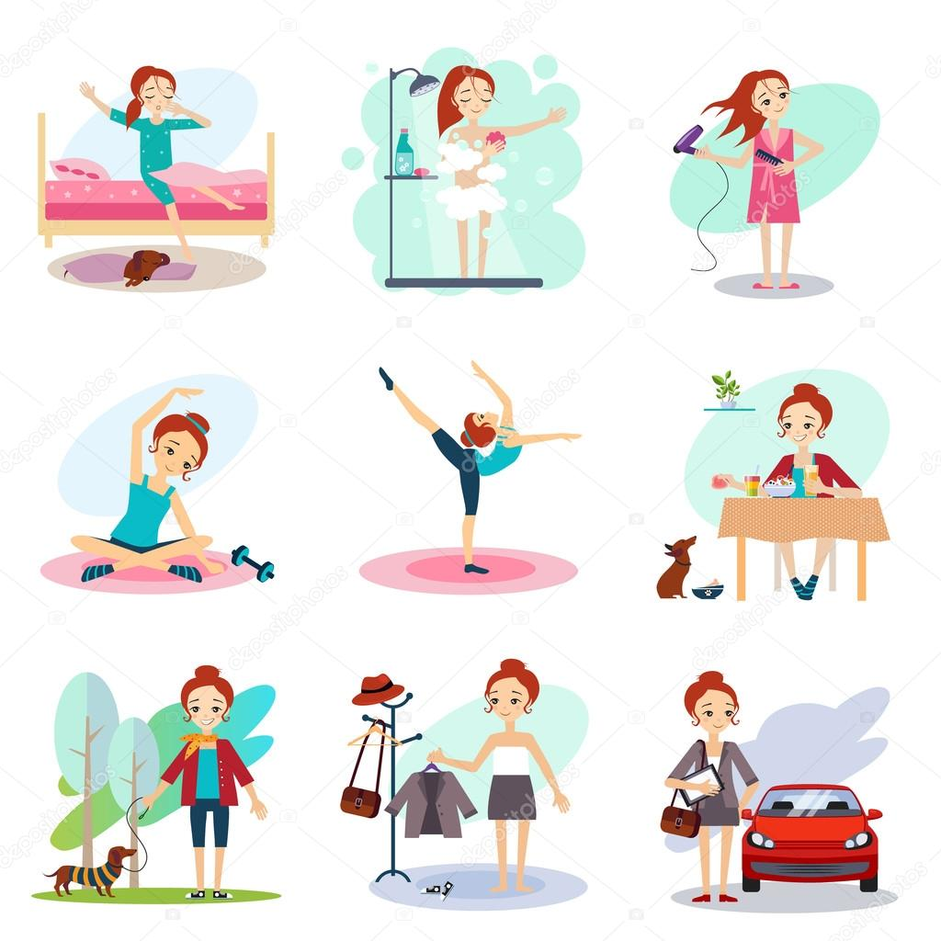
"Every morning, I get up at 6 o'clock, then I........"

Slide 4
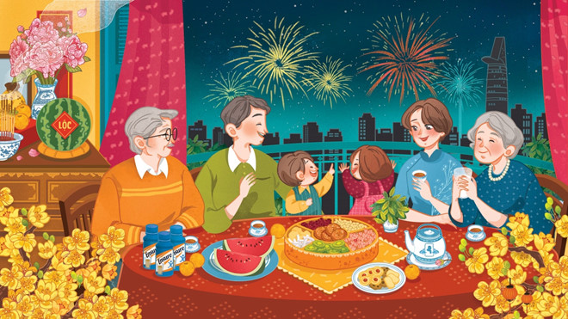
Do you like Tet? Why?

Slide 5
EXERCISE 1: Complete the questionnaire with the words in the box.
sing
dance
play
wear
celebrate
have
give
visit
go out
invite
make
HAPPY DAYS!
When it’s a special day and you want to celebrate, what do you do?
Do you ever … ?
1 . ..........songs, ...........music or ............
2. ............. or .............crazy clothes or costumes
3. ......... presents to people
4. .............with your family or friends
5. ......... people or .......... people to your house
6. ......... a special family meal

Slide 6
NEW WORDS
Celebrate (v) /ˈsel.ə.breɪt/
Dance (v) /dɑːns/a
Costume (n) /ˈkɒs.tʃuːm/
Present (n) /ˈprez.ənt/ = gift (n) /ɡɪft/
Special (adj) /ˈspeʃ.əl/

Slide 7
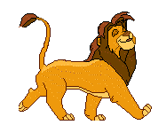

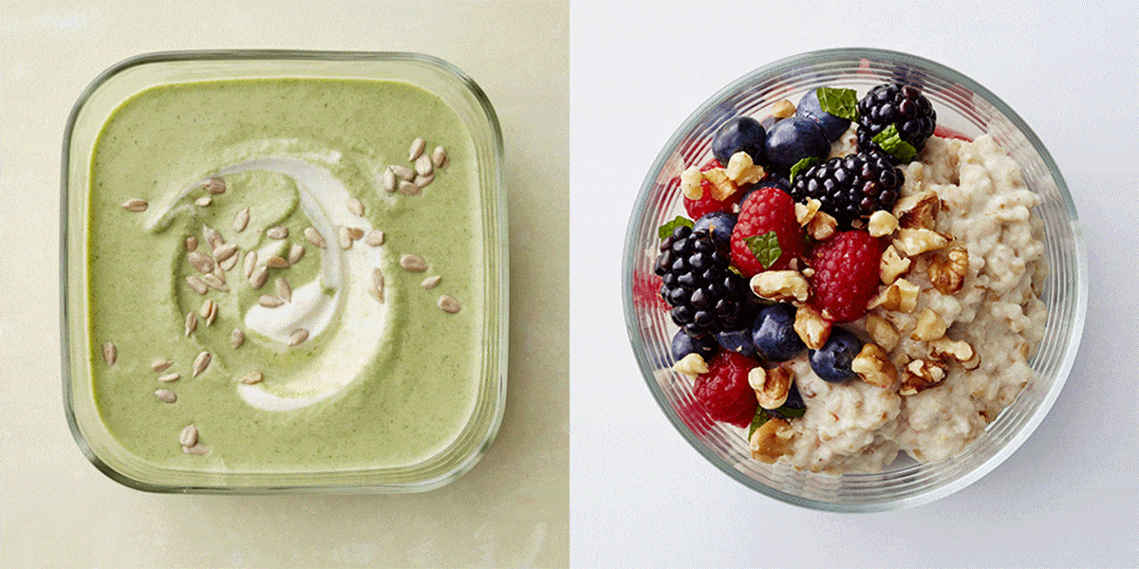

EXERCISE 2: Read the study strategy.
Firework (n) /ˈfaɪə.wɜːk/
Lion (n) /ˈlaɪ.ən
Meal (n) /mɪəl/
Envelope (n) /ˈen.və.ləʊp/

Slide 8

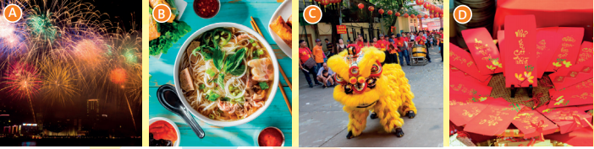
EXERCISE 3: Read the introduction to the radio programme. In what order do they mention the objects in the photo?.
1. D 2. B 3. C 4. A

Slide 9
EXERCISE 4: Listen again and write True or False.
 | True/False
1. People give money as a present at Lunar New Year.
2. People eat a lot before Lunar New Year.
3. People eat lots of meat at Lunar New Year.
4. The grandmother invites all the family to a big meal.
5. The lion only stops at some restaurants.
True
False ( People clean their houses before Lunar New Year.)
False (People often eat vegetarian food at Lunar New Year.)
True
False (The lion stops at all the restaurants.)

Slide 10
EXERCISE 4: Think of three things that you often do and three things that you don’t often do in Tet. Write sentences and say why you like or dislike them.
+ Grammar point: Frequency adverbs:
100% |  |  |  |  |  | 0%
always | usually/ normally | often | sometimes | occasionally | hardly ever | never
+ They are usually before the main verb, or between the auxiliary and the main verb. But they come after the verb to be.
Eg: I always eat breakfast before going to school.
She is never late for school.

Slide 11
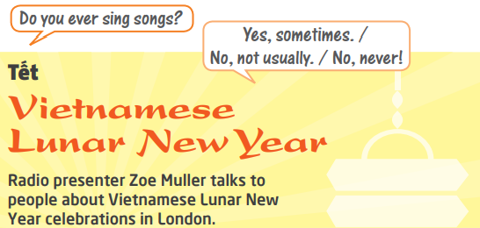
EXERCISE 4: Think of three things that you often do and three things that you don’t often do in Tet. Write sentences and say why you like or dislike them.

Slide 12
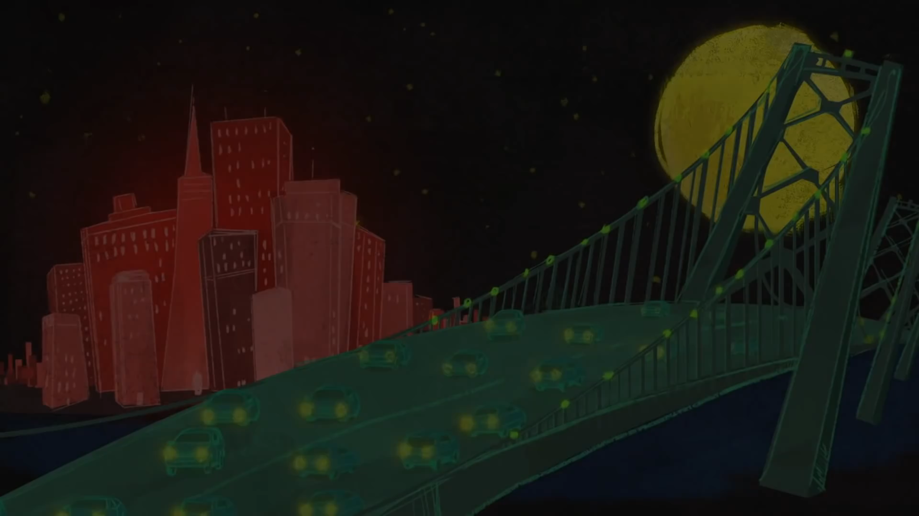

Slide 13
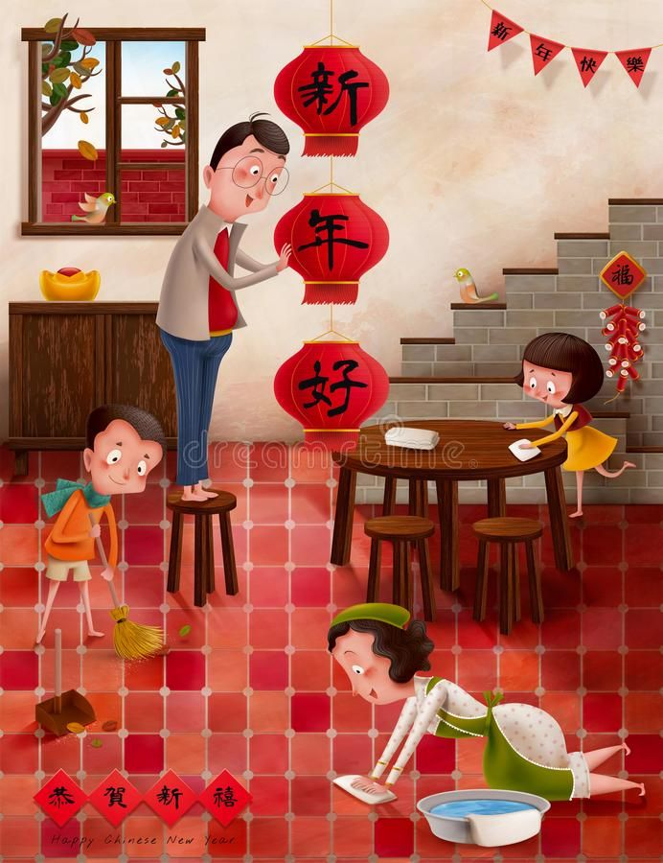
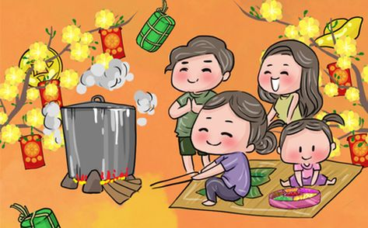
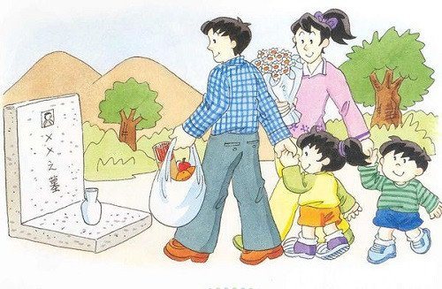
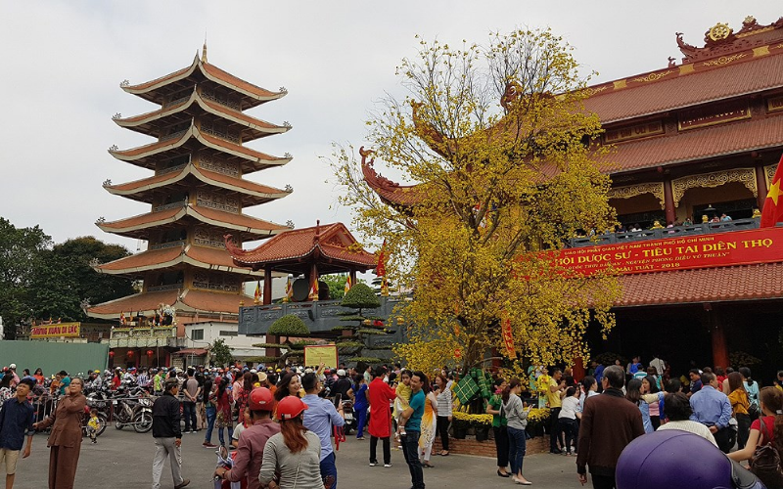
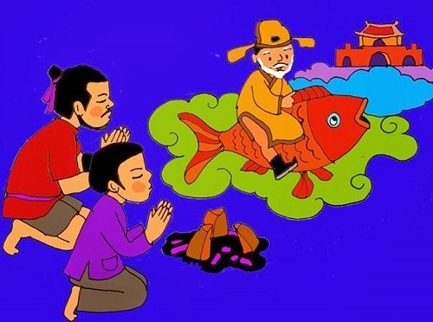
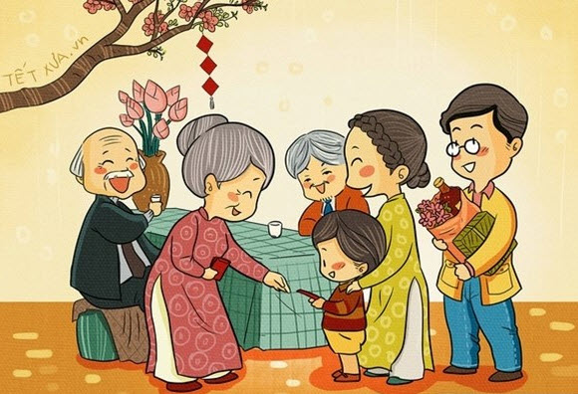
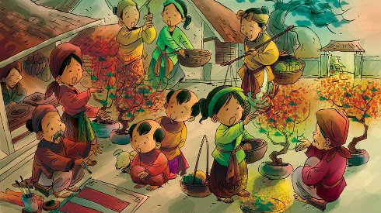
DRAW A MINDMAP
Lunar New Year

Slide 14

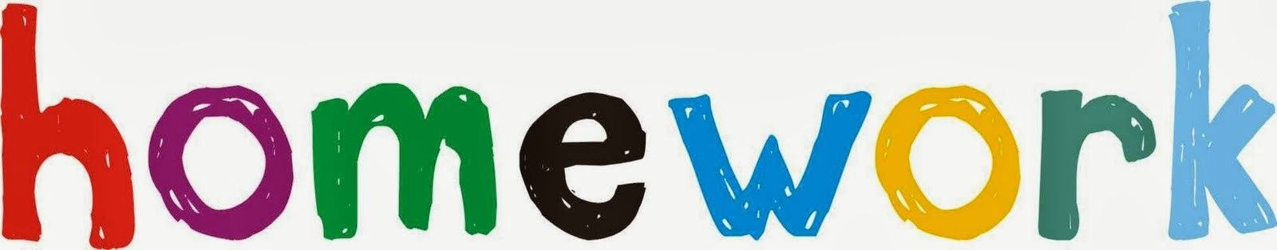
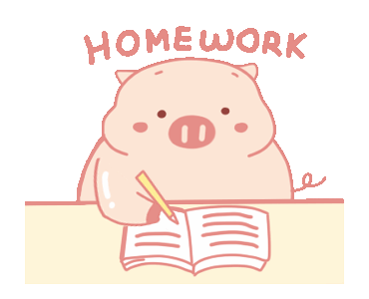
- Learn by heart all the new words and structure.
- Language focus: review simple present tense - affirmative and negative.
- Prepare for next lesson: language focus: simple present tense-questions.

